Slide 1
ATM Networks
ATM stands for Asynchronous Transfer Mode. It is a switching technique that uses time division multiplexing (TDM) for data communications.
Asynchronous Transfer Mode (ATM): It is an International Telecommunication Union- Telecommunications Standards Section (ITU-T) efficient for call relay and it transmits all information including multiple service types such as data, video or voice which is conveyed in small fixed size packets called cells. Cells are transmitted asynchronously and the network is connection oriented.
ATM is a technology which has some event in the development of broadband ISDN in 1970s and 1980s, which can be considered an evolution of packet switching. Each cell is 53 bytes long – 5 bytes header and 48 bytes payload. Making an ATM call requires first sending a message to set up a connection.

Slide 2
ATM is a technology which has some event in the development of broadband ISDN in 1970s and 1980s, which can be considered an evolution of packet switching. Each cell is 53 bytes long – 5 bytes header and 48 bytes payload. Making an ATM call requires first sending a message to set up a connection.
Subsequently all cells follow the same path to the destination. It can handle both constant rate traffic and variable rate traffic. Thus it can carry multiple types of traffic with end-to-end quality of service. ATM is independent of transmission medium, they maybe sent on a wire or fiber by themselves or they may also be packaged inside the payload of other carrier systems. ATM networks use “Packet” or “cell” Switching with virtual circuits. It’s design helps in the implementation of high performance multimedia networking.

Slide 3
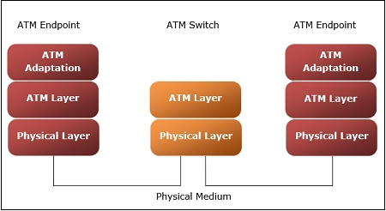

Slide 4
Benefits of ATM Networks are
It provides the dynamic bandwidth that is particularly suited for bursty traffic.
Since all data are encoded into identical cells, data transmission is simple, uniform and predictable.
Uniform packet size ensures that mixed traffic is handled efficiently.
Small sized header reduces packet overload, thus ensuring effective bandwidth usage.
ATM networks are scalable both in size and speed.

Slide 5
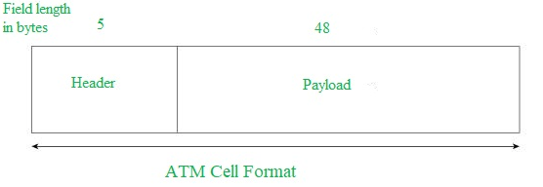
ATM Cell Format
As information is transmitted in ATM in the form of fixed size units called cells. As known already each cell is 53 bytes long which consists of 5 bytes header and 48 bytes payload.

Slide 6
Asynchronous Transfer Mode can be of two format types which are as follows:
UNI Header: which is used within private networks of ATM for communication between ATM endpoints and ATM switches. It includes the Generic Flow Control (GFC) field.
NNI Header: is used for communication between ATM switches, and it does not include the Generic Flow Control(GFC) instead it includes a Virtual Path Identifier (VPI) which occupies the first 12 bits.

Slide 7
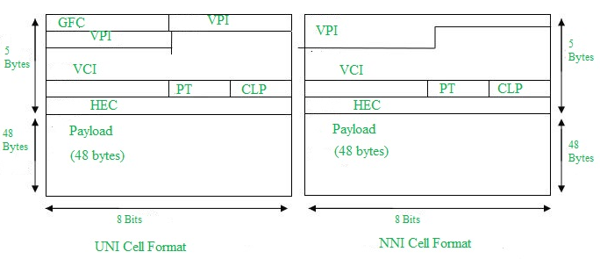

Slide 8
ATM reference model comprises of three layers
Physical Layer − This layer corresponds to physical layer of OSI model. At this layer, the cells are converted into bit streams and transmitted over the physical medium. This layer has two sub layers: PMD sub layer (Physical Medium Dependent) and TC (Transmission Convergence) sub layer.
ATM Layer −This layer is comparable to data link layer of OSI model. It accepts the 48 byte segments from the upper layer, adds a 5 byte header to each segment and converts into 53 byte cells. This layer is responsible for routing of each cell, traffic management, multiplexing and switching.
ATM Adaptation Layer (AAL) −This layer corresponds to network layer of OSI model. It provides facilities to the existing packet switched networks to connect to ATM network and use its services. It accepts the data and converts them into fixed sized segments. The transmissions can be of fixed or variable data rate. This layer has two sub layers − Convergence sub layer and Segmentation and Reassembly sub layer.
ATM endpoints − It contains ATM network interface adaptor. Examples of endpoints are workstations, routers, CODECs, LAN switches, etc.
ATM switch −It transmits cells through the ATM networks. It accepts the incoming cells from ATM endpoints (UNI) or another switch (NNI), updates cell header and retransmits cell towards destination.

Slide 9
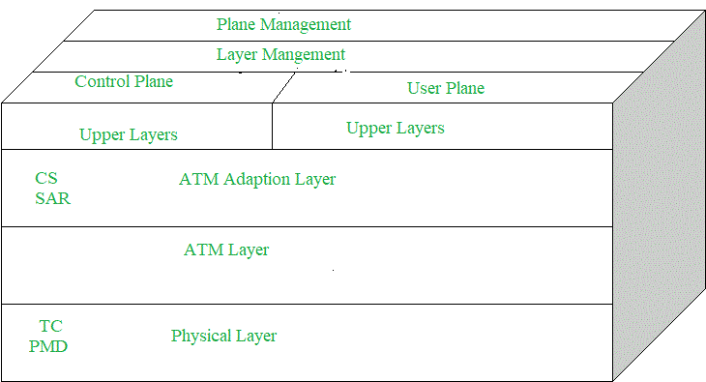
ATM LAYER/ARCHITECTURE/STRUCTURE

Slide 10
ATM Adaption Layer (AAL) – It is meant for isolating higher layer protocols from details of ATM processes and prepares for conversion of user data into cells and segments it into 48-byte cell payloads. AAL protocol excepts transmission from upper layer services and help them in mapping applications, e.g., voice, data to ATM cells.
Physical Layer – It manages the medium-dependent transmission and is divided into two parts physical medium-dependent sublayer and transmission convergence sublayer. Main functions are as follows:
It converts cells into a bit stream.
It controls the transmission and receipt of bits in the physical medium.
It can track the ATM cell boundaries.
Looks for the packaging of cells into appropriate type of frames.
ATM Layer – It handles transmission, switching, congestion control, cell header processing, sequential delivery, etc., and is responsible for simultaneously sharing the virtual circuits over the physical link known as cell multiplexing and passing cells through ATM network known as cell relay making use of the VPI and VCI information in the cell header

Slide 11
ATM Applications:
ATM WANs – It can be used as a WAN to send cells over long distances, router serving as a end-point between ATM network and other networks, which has two stacks of protocol.
Multimedia virtual private networks and managed services – It helps in managing ATM, LAN, voice and video services and is capable of full-service virtual private-networking, which includes integrated access of multimedia.
Frame relay backbone – Frame relay services are used as a networking infrastructure for a range of data services and enabling frame relay ATM service to Internetworking services.
Residential broadband networks – ATM is by choice provides the networking infrastructure for the establishment of residential broadband services in search for highly scalable solutions.
Carrier infrastructure for telephone and private line networks – To make more effective use of SONET/SDH fiber infrastructures by building the ATM infrastructure for carrying the telephonic and private-line traffic.

